Slide 1

Chapter 12
Multiple Access
12.1
Copyright © The McGraw-Hill Companies, Inc. Permission required for reproduction or display.
Notes:
1

Slide 2
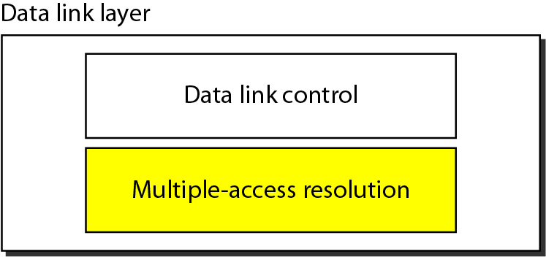
Figure 12.1 Data link layer divided into two functionality-oriented sublayers
12.2
Notes:
2

Slide 3
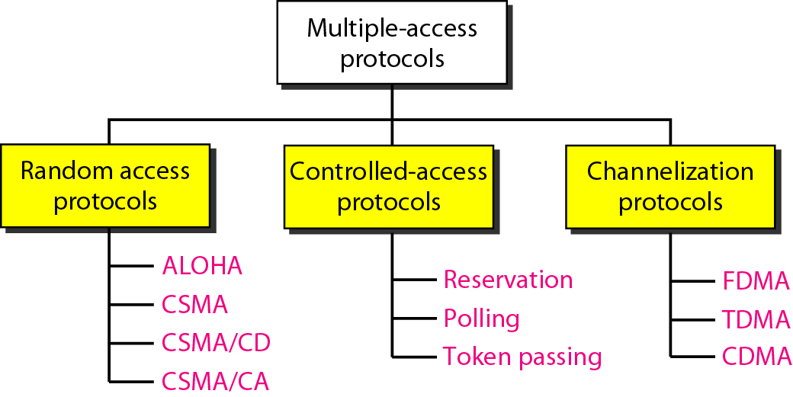
Figure 12.2 Taxonomy of multiple-access protocols discussed in this chapter
12.3
Notes:
3

Slide 4
12-1 RANDOM ACCESS
In random access or contention methods, no station is superior to another station and none is assigned the control over another. No station permits, or does not permit, another station to send. At each instance, a station that has data to send uses a procedure defined by the protocol to make a decision on whether or not to send.
Topics discussed in this section:
ALOHA Carrier Sense Multiple Access
Carrier Sense Multiple Access with Collision Detection
Carrier Sense Multiple Access with Collision Avoidance
12.4
Notes:
4

Slide 5
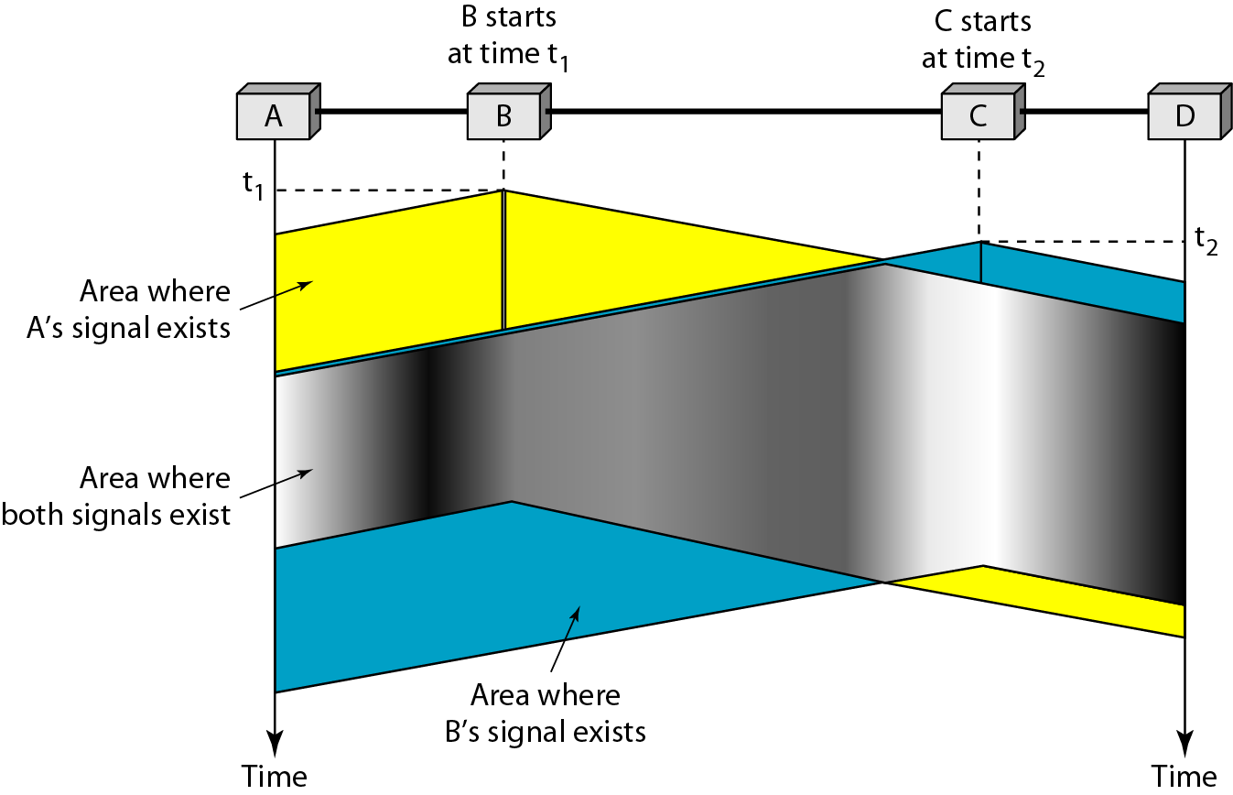
Figure 12.8 Space/time model of the collision in CSMA
12.5
Notes:
5

Slide 6
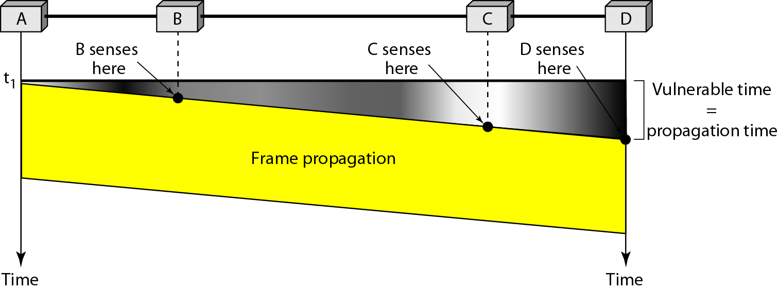
Figure 12.9 Vulnerable time in CSMA
12.6
Notes:
6

Slide 7
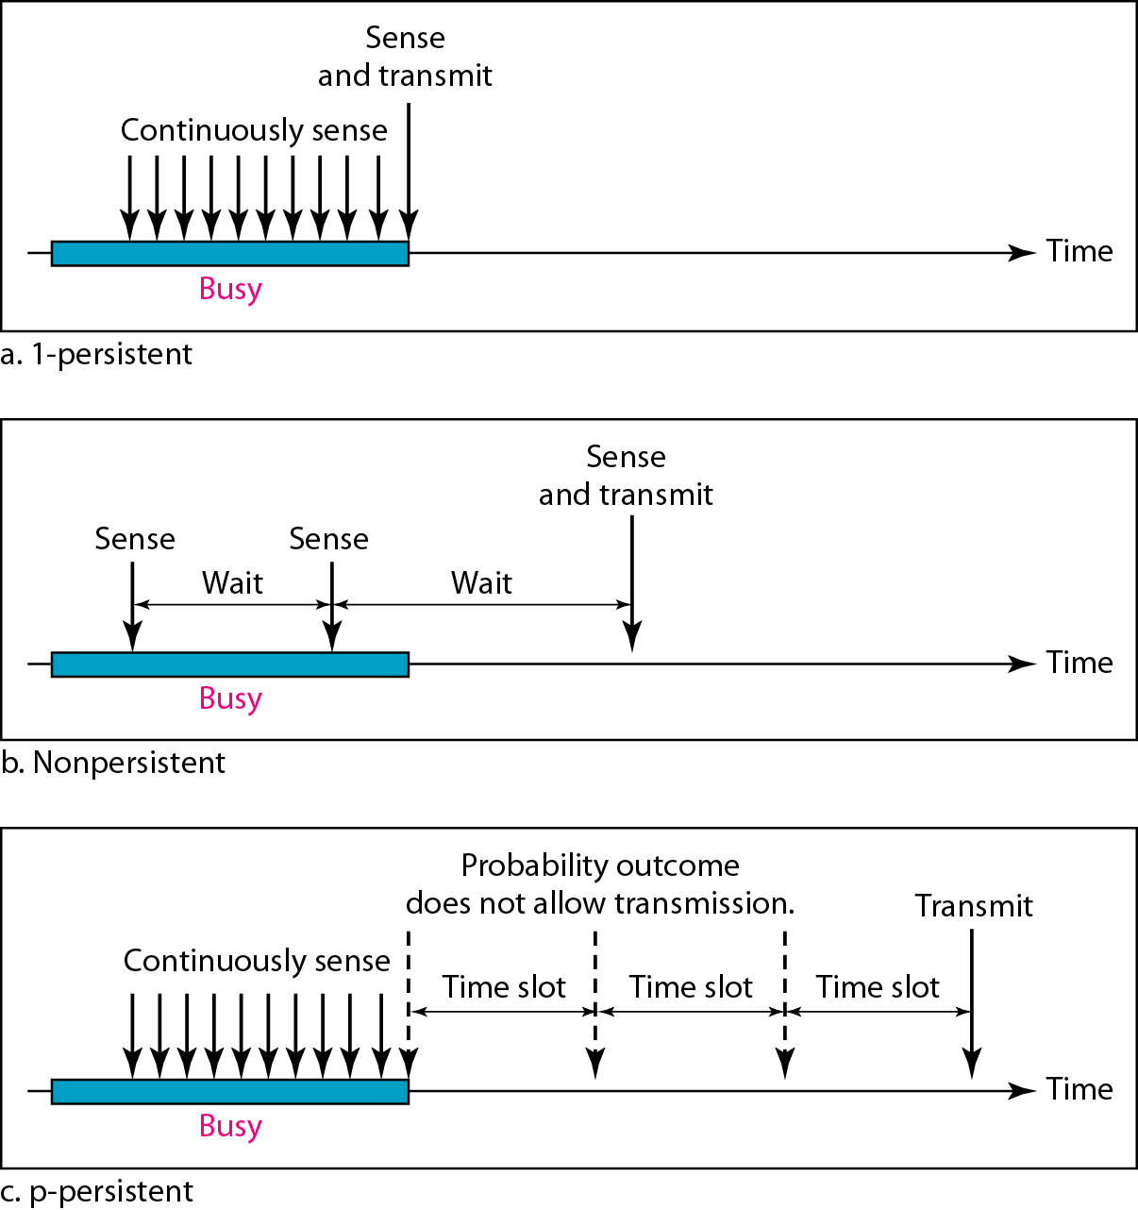
Figure 12.10 Behavior of three persistence methods
12.7
Notes:
7

Slide 8
1-Persistent
The 1-persistent method is simple and straightforward.
In this method, after the station finds the line idle, it sends its frame immediately (with probability 1).
This method has the highest chance of collision because two or more stations may find the line idle and send their frames immediately.
Nonpersistent
In the nonpersistent method, a station that has a frame to send senses the line.
If the line is idle, it sends immediately. If the line is not idle, it waits a random amount of time and then senses the line again.
The nonpersistent approach reduces the chance of collision because it is unlikely that two or more stations will wait the same amount of time and retry to send simultaneously.
However, this method reduces the efficiency of the network because the medium remains idle when there may be stations with frames to send.
12.8

Slide 9
p-Persistent
The p-persistent method is used if the channel has time slots with a slot duration equal to or greater than the maximum propagation time.
The p-persistent approach combines the advantages of the other two strategies.
It reduces the chance of collision and improves efficiency. In this method, after the station finds the line idle it follows these steps:
1. With probability p, the station sends its frame.
2. With probability q = 1 − p, the station waits for the beginning of the next time slot and checks the line again.
a. If the line is idle, it goes to step 1.
b. If the line is busy, it acts as though a collision has occurred and uses the backoff
procedure.
12.9
Notes:
9

Slide 10
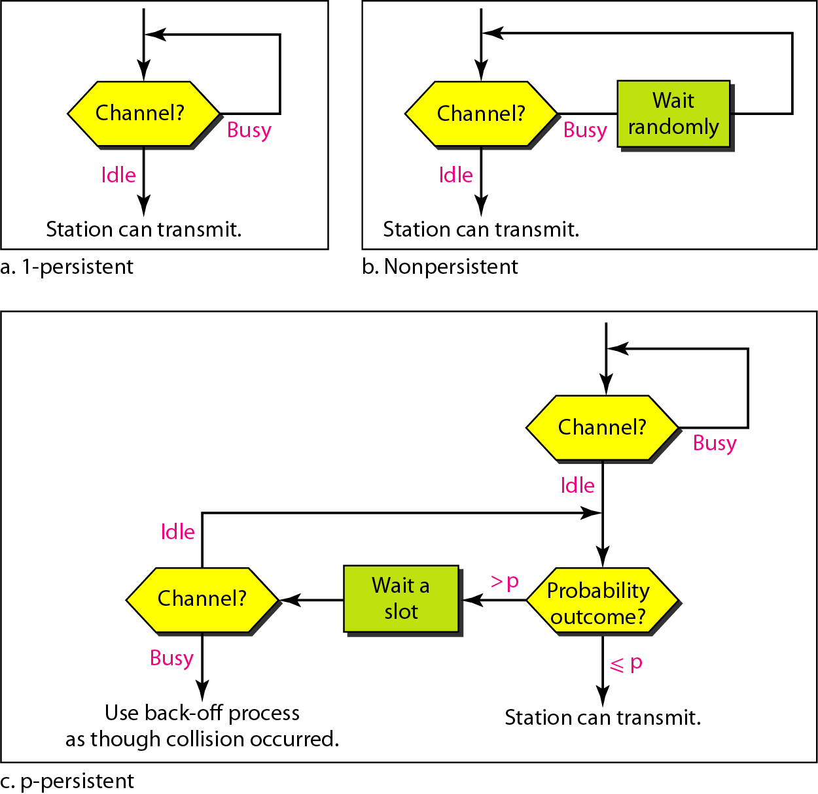
Figure 12.11 Flow diagram for three persistence methods
12.10
Notes:
10

Slide 11
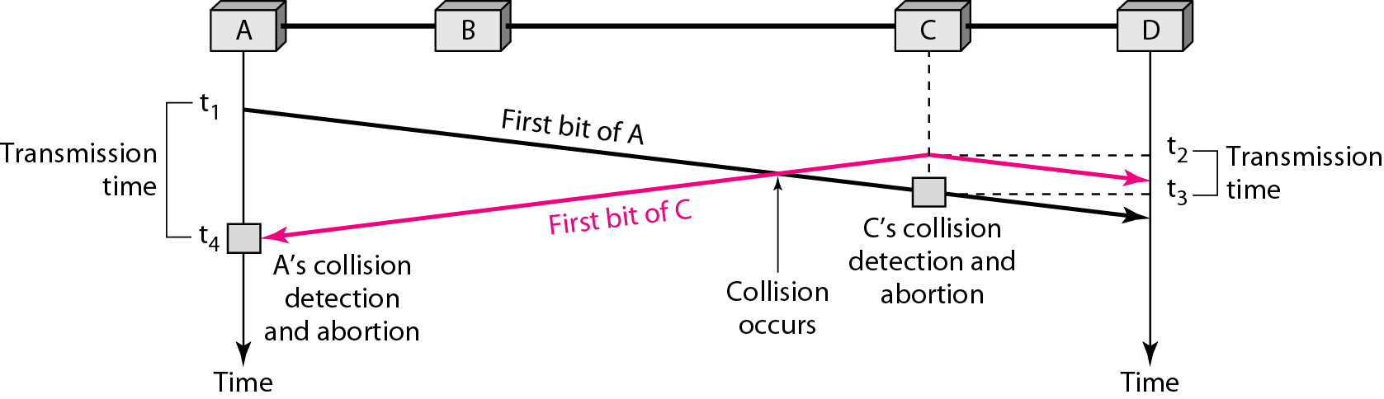
Figure 12.12 Collision of the first bit in CSMA/CD
12.11
Notes:
11

Slide 12
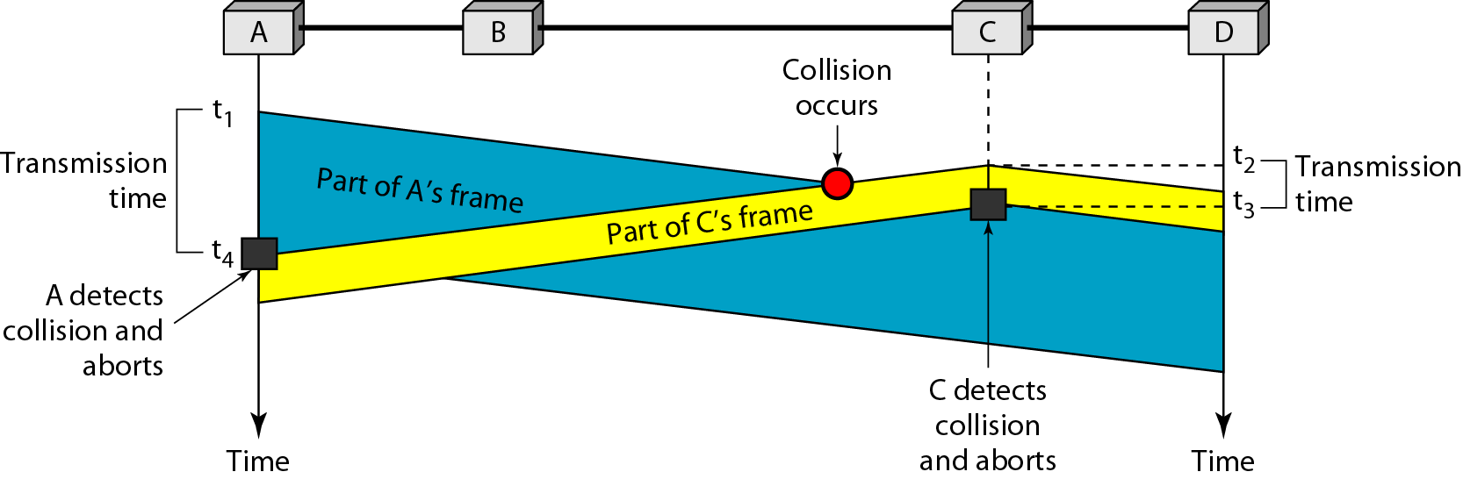
Figure 12.13 Collision and abortion in CSMA/CD
12.12
Notes:
12

Slide 13
Example 12.5
A network using CSMA/CD has a bandwidth of 10 Mbps. If the maximum propagation time (including the delays in the devices and ignoring the time needed to send a jamming signal, as we see later) is 25.6 μs, what is the minimum size of the frame?
Solution
The frame transmission time is T_{fr} = 2 × T_{p} = 51.2 μs. This means, in the worst case, a station needs to transmit for a period of 51.2 μs to detect the collision. The minimum size of the frame is 10 Mbps × 51.2 μs = 512 bits or 64 bytes. This is actually the minimum size of the frame for Standard Ethernet.
12.13
Notes:
13

Slide 14
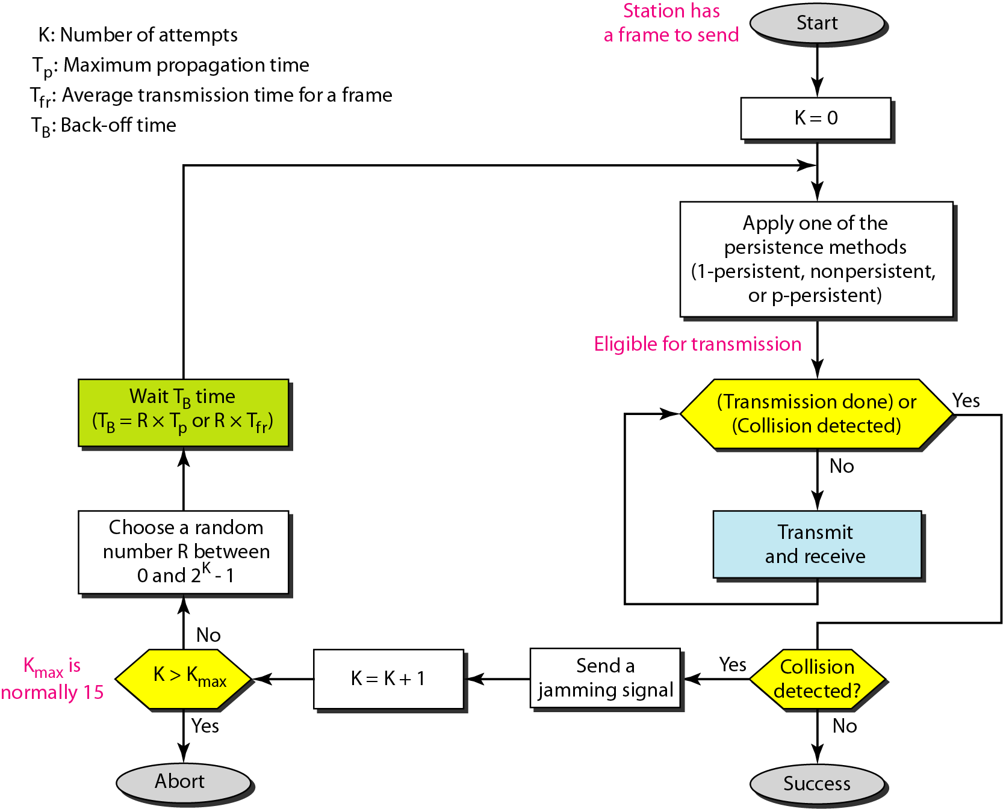
Figure 12.14 Flow diagram for the CSMA/CD
12.14
Notes:
14

Slide 15
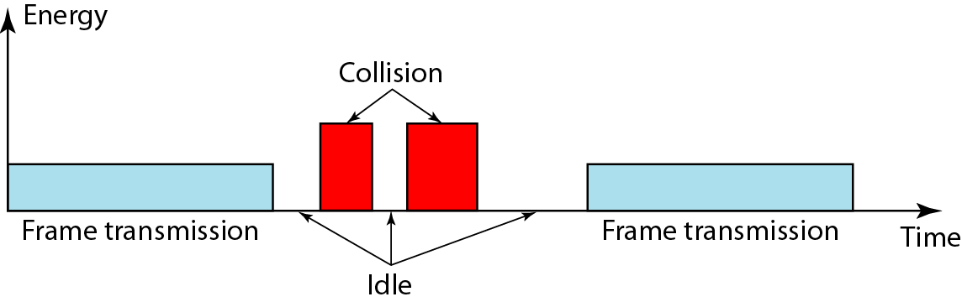
Figure 12.15 Energy level during transmission, idleness, or collision
12.15
Notes:
15

Slide 16
CSMA / CA
Carrier sense multiple access with collision avoidance (CSMA/CA) was invented for wireless networks.
Collisions are avoided through the use of three strategies:
Interframe space (IFS)
Contention window
Acknowledgments
When an idle channel is found, the station does not send immediately. It waits for a period of time called IFS.
The IFS time allows the front of the transmitted signal by the distant station to reach this station.
After waiting an IFS time, if the channel is still idle, the station can send, but it still needs to wait a time equal to the contention window
The contention window is an amount of time divided into slots. A station that is ready to send chooses a random number of slots as its wait time. The number of slots in the window changes according to the binary exponential back-off strategy.
One interesting point about the contention window is that the station needs to sense the channel after each time slot.
However, if the station finds the channel busy, it does not restart the process; it just stops the timer and restarts it when the channel is sensed as idle.

Slide 17
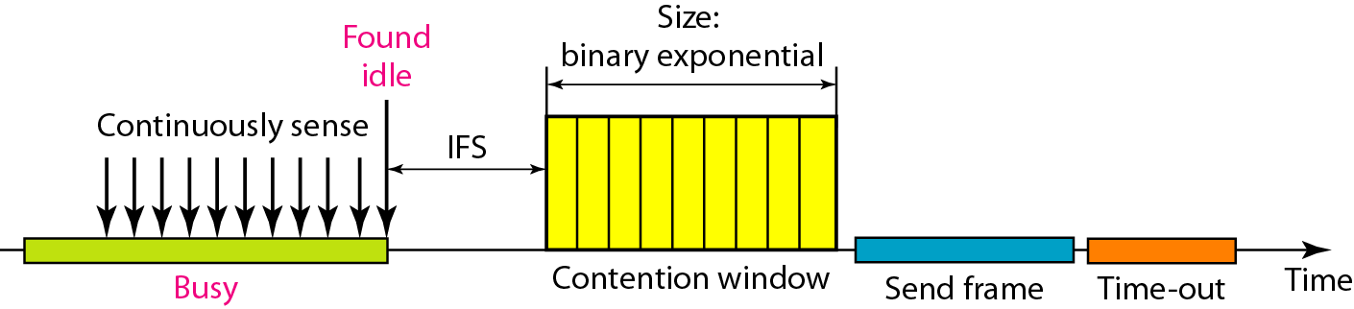
Timing in CSMA/CA
Acknowledgment.
With all these precautions, there still may be a collision resulting in destroyed data.
In addition, the data may be corrupted during the transmission.
The positive acknowledgment and the time-out timer can help guarantee that the receiver has received the frame.

Slide 18

Note
In CSMA/CA, the IFS can also be used to define the priority of a station or a frame.
12.18
Notes:
18

Slide 19
Note
In CSMA/CA, if the station finds the channel busy, it does not restart the timer of the contention window;
it stops the timer and restarts it when the channel becomes idle.
12.19
Notes:
19

Slide 20
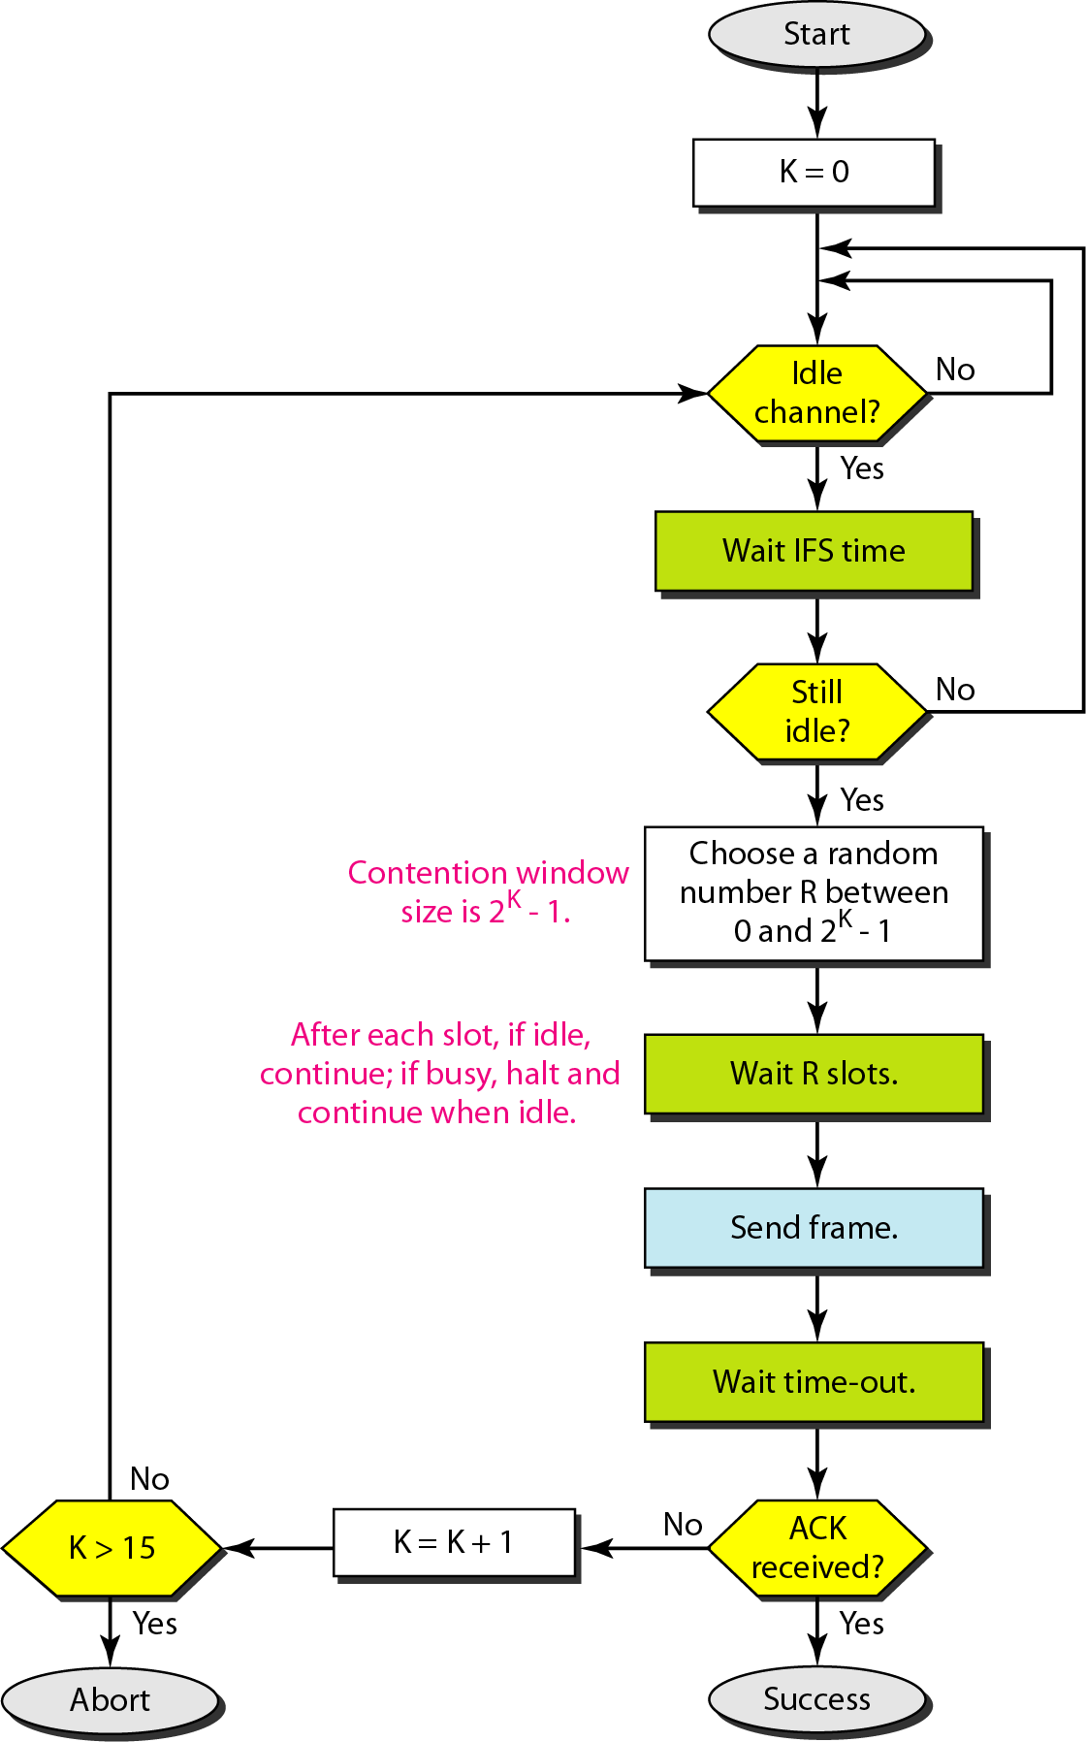
Figure 12.17 Flow diagram for CSMA/CA
12.20
Notes:
20

Slide 21
Difference between CSMA-CD & CSMA-CA
CSMA-CD | CSMA-CA
Effective after a collision. | Effective before a collision
It only reduces the recovery time | CSMA-CA minimizes the possibility of collision
Used in wired networks | Used in wireless networks
CSMA-CD resend the data frame whenever a conflict occurs. | CSMA / CA will first transmit the intent to send for data transmission.
CSMA-CD is used in IEEE 802.3 standard | CSMA / CA is used in IEEE 802.11 standard.

Slide 22
12-2 CONTROLLED ACCESS
In controlled access, the stations consult one another to find which station has the right to send. A station cannot send unless it has been authorized by other stations. We discuss three popular controlled-access methods.
Topics discussed in this section:
Reservation Polling Token Passing
12.22
Notes:
22

Slide 23
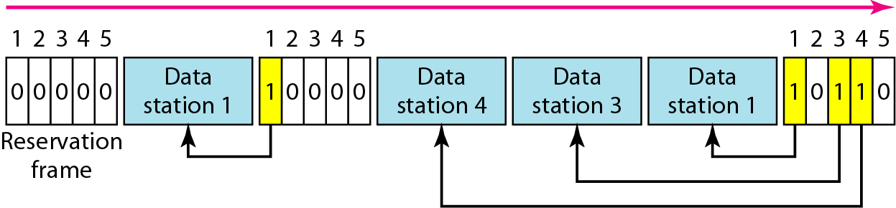
Figure 12.18 Reservation access method
12.23
Notes:
23

Slide 24
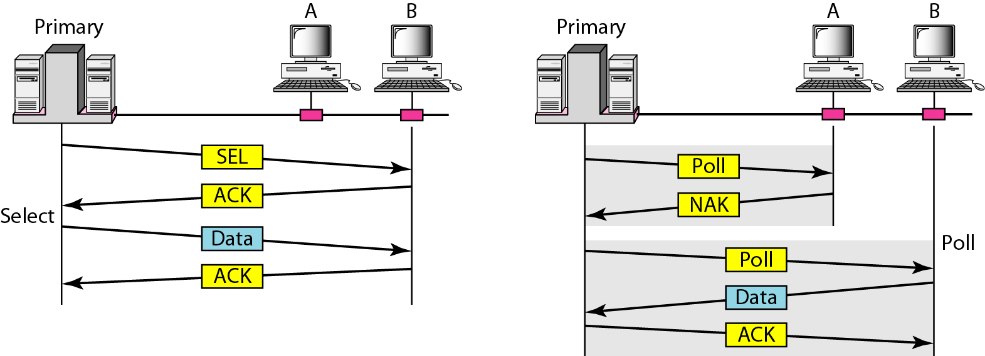
Figure 12.19 Select and poll functions in polling access method
12.24
Notes:
24

Slide 25
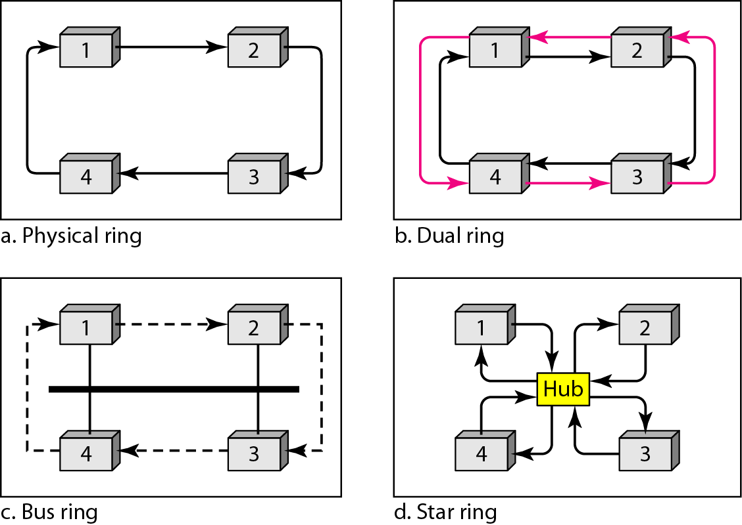
Figure 12.20 Logical ring and physical topology in token-passing access method
12.25
Notes:
25

Slide 26

Token ring
Token ring is used in IEEE 802.5 standard
4 and 16 Mbps is the supported data rate
Twisted pair cabling with Differential Manchester Line coding
Channel access method is Token passing
Each station take turns in sending data and can transmit only during its turn
May send only one frame during each turn
Whenever a station wishes to send a frame, it first waits for the token. When the station gets the token, it start sending frame
The intended recipient retains a copy of the frame and indicates by setting the response bits at the tail of the frame

Slide 27
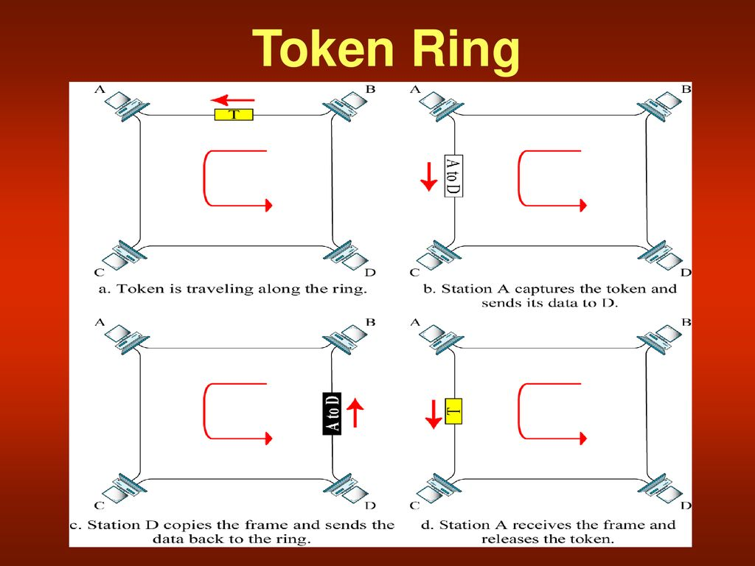

Slide 28
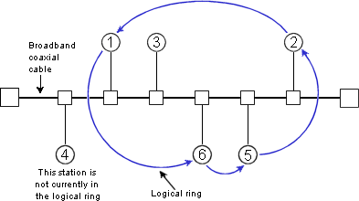
Token Bus
Token Bus is used in IEEE 802.4 standard
Channel access method is Token passing
Token bus is a logical ring on a physical bus topology
The network is physically a bus topology and logically arranged as a ring with respect to passing the token from node to node

Slide 29
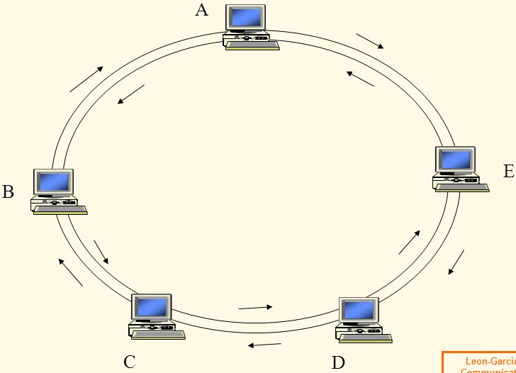
FDDI
Fiber Distributed Data Interface (FDDI) standardized by ANSI and ITU-T
It uses Dual ring, one act as primary and the other as secondary
Normally secondary ring is idle and used for redundancy for auto repairing
Supported data rate is 100 Mbps
Access method: Token passing
Permits up to 500 stations and spans up to 200 Km
Uses 4B/5B encoder
Uses 1300 nm wavelength light source

Slide 30
FDDI- Time registers
FDDI defines 3 time registers to control the circulation of the token and to distribute link access opportunities equally to all the nodes in the n/w. The 3 registers are
Synchronous Allocation (SA)
Target Token Rotation Time (TTRT)
Absolute Maximum Time (AMT)
Values of these registers are set when the ring is initialized and do not vary in the course of operation
Synchronous Allocation- Time allowed for each station to send synchronous data. This value is different for each station and its negotiated during initialization of the ring
TTRT- Average time required for a token to circulate around the ring once.
AMT- Its value is twice the TTRT . It’s the maximum time a token take to complete one rotation, beyond which the token is reinitialized

Slide 31
FDDI -Timers
Each station contains a set of timers that compare the actual timings with the values in the time registers. FDDI uses 2 timers and they are
Token Rotation Timer (TRT)
Token Holding Timer (THT)
TRT: Runs continuously and measures the actual time taken by the token to complete one rotation. We use an incrementing TRT.
THT: Begins running as soon as the token is received and it shows how much time remains for sending asynchronous frames, once synchronous frames have been sent. We use decrementing THT
Station Procedure
When a token arrives, each station follows this procedure
THT is set to TTRT – TRT
TRT is set to 0
Station sends its synchronous data first
Station sends asynchronous data as long as THT is positive

